Slide 1
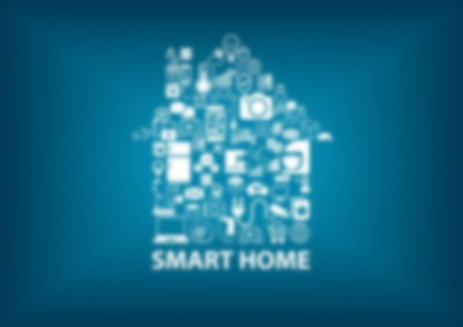

SMART CONTROL SYSTEM
IoT Based Home Automation Software
Developed by : Abhinaba Ghosh
Copyright: 2021 || Ver: Beta_1.0

